Slide 1
INFORMATION SYSTEMS AND THEIR ROLE IN THE ORGANIZATION

Slide 2

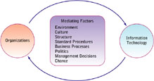
RELATIONSHIP BETWEEN ORGANIZATION AND INFORMATION TECHNOLOGY

Slide 3
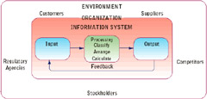
RELATIONSHIP BETWEEN ORGANIZATION AND INFORMATION TECHNOLOGY
Functions of an information system

Slide 4
RELATIONSHIP BETWEEN ORGANIZATION AND INFORMATION TECHNOLOGY
These figures shown have many things in common. Both require inputs and some sort of processing, both have outputs, and both then depend on feedback for successful completion of the loop.
Information Systems use data as their main ingredient. Organizations rely on people. However, the similarities are remarkable. They are both a structured method of turning raw products (data/people) into useful entities (information/products).

Slide 5
RELATIONSHIP BETWEEN ORGANIZATION AND INFORMATION TECHNOLOGY
Organization:
An Organization is a stable, formal social structure that takes resources from the Environment and processes them to produce outputs. i.e. technical view
Organizations are also considered as Formal Legal Entities with internal Rules and Procedures that must abide by laws.
Organizations are also Social Structures because they are a collection of social elements
The Technical side of Organization focuses on three elements:
Capital, Labour, Environment
Capital and Labour are primary production factors provided by the Environment. The Organization transforms these inputs into products and services in a Production function.
Technical view of Organization encourages us to focus on how inputs are combined to create outputs when technology changes are introduced into the Organization.

Slide 6
RELATIONSHIP BETWEEN ORGANIZATION AND INFORMATION TECHNOLOGY
Behavioral Definition of Organization:
Collection of rights, privileges, obligations, and responsibilities delicately balanced over a period of time through conflict and the conflict resolution.
All organizations have some similar “structural” features.
The Technical and Behavioural definitions of Organizations are not contradictory but complementary in other words they complement each.

Slide 7
RELATIONSHIP BETWEEN ORGANIZATION AND INFORMATION TECHNOLOGY
Shared Features of all Organizations:
Clear division of labor and professionalism
Hierarchy-bureaucracy, accountability and authority
Explicit rules and procedures
Impartial judgments and universal decision making
Technical qualifications for positions
Maximum organizational efficiency- Maximizing Output using limited Input.

Slide 8
RELATIONSHIP BETWEEN ORGANIZATION AND INFORMATION TECHNOLOGY
A group of people with a purpose is an example of an organization.
You had a leader (hierarchy)
Set of rules by which you operated (explicit rules and procedures)
People appointed to perform certain tasks (clear division of labor).
You probably voted on different issues (impartial judgments)
There was on the best person to fill various positions within the group (technical qualifications for positions).
The organization was able to fulfill its goals (maximum organizational efficiency)

Slide 9
RELATIONSHIP BETWEEN ORGANIZATION AND INFORMATION TECHNOLOGY
Organizational Politics
Everyone has their own opinion about how things should get done. People have competing points of view. What might be good for Accounting may not be to the advantage of Human Resources.
When it comes to the allocation of important resources in an organization, competition heats up between people and departments.
The internal competition can have a positive or negative influence on the organization, depending on how it's handled by management.
The fact remains that politics exist in every organization and should be taken into account when it comes to the structure of the information system.

Slide 10
RELATIONSHIP BETWEEN ORGANIZATION AND INFORMATION TECHNOLOGY
Organizational Culture
Different countries or groups of people have their own habits, methods, norms, and values.
The same aspects apply to businesses. It's not unusual for companies to experience clashes between the culture and desired changes brought about by new technologies.
Many companies are facing such challenges as they move toward a totally different way of working that has been revolutionized by technology e.g. Internet.
Organizations and Environments
Some organizations are able to respond faster and better than others. An organization should respond rapidly to changing consumer requirements and tastes if it needs to maintain its market share.

Slide 11
RELATIONSHIP BETWEEN ORGANIZATION AND INFORMATION TECHNOLOGY
How do organizations differ?
Organizations differ because their ultimate goals, sizes and environmental factors are different. Many external factors are out of an organization’s control.
The employees of company that deals with products and services must respond quickly to potential customers or they simply won't make any money. This type of organization must be creative in the way it generates business and in the systems it uses.
On the other hand, an insurance company has relatively stable customers. People sign up with the insurer and pay their premiums on a regular basis. While customers may come and go, turnover is fairly low.

Slide 12
RELATIONSHIP BETWEEN ORGANIZATION AND INFORMATION TECHNOLOGY
How do organizations differ?
Most state governments require people to carry insurance, the company and its agents have a stable stream of income from premiums. It doesn't have to devise ingenious ways of using or generating data, and its systems needs are very ordinary.
Both businesses are small and entrepreneurial. But they must respond to employees, customers, and potential customers in very different ways.
Each organization has different business processes it must use to meet the goal of staying in business.

Slide 13
RELATIONSHIP BETWEEN ORGANIZATION AND INFORMATION TECHNOLOGY
Other Differences among Organizations
There are many external forces on an organization. These forces are causing many organizations-public, private, and governmental-to re-evaluate and alter their organizations because of the Internet. Some organizations are responding faster and easier than others.
The structure of the organization is major influence on how it can respond rapidly to external environmental factors.
If the structure and culture of the organization promotes new ideas, new products, and new methods, the organization can deal with environmental changes faster than a more rigid organizational structure.
Some companies are simply so big that they can't change their structure as fast as technology demands.

Slide 14
HOW INFORMATION SYSTEMS IMPACT ORGANIZATIONS AND BUSINESS FIRMS
Economic theory
From the point of view of economics, IT changes both the relative costs of capital and the costs of information.
Technology is helping organizations reduce the costs of doing business. The transaction cost theory supports the idea that through technology, businesses can reduce the costs of processing transactions with the same zeal that they use to reduce production costs
Information systems technology can be viewed as a factor of production that can be substituted for traditional capital and labor.

Slide 15
HOW INFORMATION SYSTEMS IMPACT ORGANIZATIONS AND BUSINESS FIRMS
Information Technology flattens Organizations
Managers now receive so much more accurate and timely information and become much faster at making decisions, so fewer managers are required.
Broadening ‘Span of Control ‘enables high-level managers to manage and control many more workers spread over greater distances.
Many companies have eliminated thousands of middle managers as a result Broadening span of control.
Management costs decline as a percentage of revenues, and the hierarchy becomes much more efficient.

Slide 16
HOW INFORMATION SYSTEMS IMPACT ORGANIZATIONS AND BUSINESS FIRMS
Behavioral Theory
Technology doesn't automatically transform organizations. Companies cannot have all their problems solved just because they install the latest information system.
People using technology efficiently and effectively, however, can transform organizations.
Communications up and down the organization and from one department to another on the same managerial level can be enhanced and increased by using technology. The lines of communication are shorter, clearer, and more concise.
Technology makes virtual organizations more feasible, cheaper, and easier to set up and tear down than before.
If you had a small group of people from each functional area of the company collaborating on a new production method, you can bring them together, formulate the new methodology, and then return them to their regularly assigned units.

Slide 17
HOW INFORMATION SYSTEMS IMPACT ORGANIZATIONS AND BUSINESS FIRMS
By using technology, most of the collaboration and communication throughout the organization, top to bottom, side to side, could be accomplished quicker and cheaper.
The decision-making process can be pushed to lower levels, and management can check progress electronically.
The behavioral theory of the integration of Information Systems in an organization says that the political structure of an organization changes through access to information.
Understanding organizational resistance to change
When a company introduces change to the organizational structure because of a new or revamped information system, political changes will occur at the same time.
Information systems potentially change an organization’s structure, culture, business processes and strategy. There is often considerable resistance to them when they are introduced especially if they affect them negatively.

Slide 18
HOW INFORMATION SYSTEMS IMPACT ORGANIZATIONS AND BUSINESS FIRMS
The Internet and Organizations
The Internet increases the accessibility, storage, distribution of information and knowledge for business firms.
The Internet lowers the transaction costs and agency costs of firms. Agency costs are the costs associated with supervising employees.
Businesses are rapidly rebuilding their key business processes based on Internet technology. Example: online order entry, customer service, and fulfillment of orders.

Slide 19
HOW INFORMATION SYSTEMS IMPACT ORGANIZATIONS AND BUSINESS FIRMS
Impacts of IT on management decision making
Information Systems help improve the decision-making process by;
Providing more information about the problem
Presenting a greater variety of possible alternatives
Showing consequences and effects of choices
Measuring the outcome of different possible solutions
Providing feedback on the decision that is made

Slide 20
HOW INFORMATION SYSTEMS IMPACT ORGANIZATIONS AND BUSINESS FIRMS
NB: Different types of decisions require different types of systems. All decisions follow the same pattern although some may be more complex and require several iterations of the decision-making stages.
Decision Making in the Real World
In the real world, investments in decision-support systems do not always work because of
Information quality: Accuracy, integrity, consistency, completeness, validity, timeliness, accessibility
Management filters: Biases and bad decisions of managers
Organizational inertia: Strong forces within organization that resist change

Slide 21
HOW INFORMATION SYSTEMS IMPACT ORGANIZATIONS AND BUSINESS FIRMS
Decision models
Rational model:
An individual manager identifies goals, ranks all possible alternative actions and chooses the alternative that contributes most to those goals. It is based on the choice that would maximize the biggest payoff value for the organization.
The manager is assumed to be a totally informed person to choose the most efficient alternative for maximum output.
Bureaucratic model:
Whatever organizations do is the result of routines and existing business processes honed over years of active use.
In this model its assumed that the main goal of an organization is preservation or survival.
This model uses standard operating procedures based on previous decisions and work habits to determine how tasks are accomplished.

Slide 22
HOW INFORMATION SYSTEMS IMPACT ORGANIZATIONS AND BUSINESS FIRMS
Political model:
What an organization does is a result of political bargains struck among key leaders and interest groups.
The decision-making process in the political model is based not necessarily on what's good for the organization, but on what's good for the players involved.
Compromise is more the norm than clear-cut decisions. The goal of this type of organization is to blend the interests of the players into a decision that satisfies as many people or entities as possible.
The political model views decision making as a process of conflict resolution and consensus building and decisions as products of compromise.

Slide 23
HOW INFORMATION SYSTEMS IMPACT ORGANIZATIONS AND BUSINESS FIRMS
Garbage can model:
The Garbage can decision model developed to describe organizations run by organized chaos (they have high uncertainty in both problem identification and problem solution.)
The model for organized chaos has three characteristics:
They have substantial disagreement on what their goals are, and they poorly understood technology.
They find cause & effect relationships difficult, if not impossible to identify.
They also have a high turnover of participants.
Problems can be repetitive and difficult to solve by anyone, and can include such issues as parking problems, enrollment diversity, intellectual climate, etc.

Slide 24
HOW INFORMATION SYSTEMS IMPACT ORGANIZATIONS AND BUSINESS FIRMS
Garbage can model:
The garbage can decision model is multi-stream event processing system.
Problems and potential solutions are filtered through to the garbage can. Problems are deemed anything that is at a point of dissatisfaction with the status quo.
Potential solutions are not particularly qualified, in that they are just an idea thrown out by someone
A good example would be universities and unfortunately government.

Slide 25
HOW INFORMATION SYSTEMS IMPACT ORGANIZATIONS AND BUSINESS FIRMS
Organizing the Information Systems Function
Small companies often rely on a single person for information technology services rather than an information systems department
Some large firms with IS departments decentralize them so that each functional area of the business has its own information systems
Other large firms may depend on a central department that makes technology decisions for the entire company

Slide 26
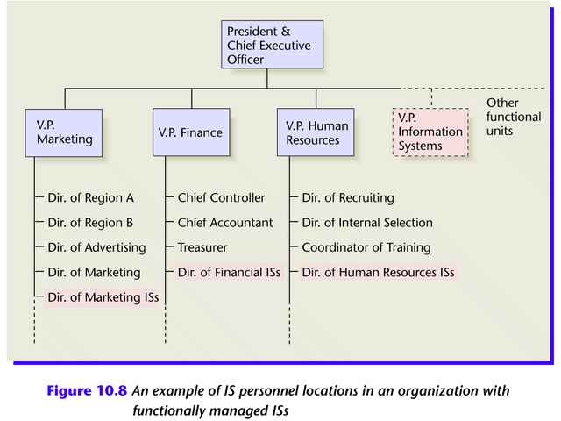
HOW INFORMATION SYSTEMS IMPACT ORGANIZATIONS AND BUSINESS FIRMS
Figure 10.8 An example of IS personnel locations in an organization with functionally managed ISs

Slide 27
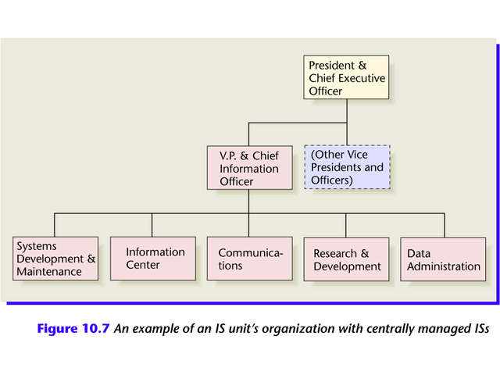
HOW INFORMATION SYSTEMS IMPACT ORGANIZATIONS AND BUSINESS FIRMS
Figure 10.7 An example of an IS unit’s organization with centrally managed ISs

Slide 28
HOW INFORMATION SYSTEMS IMPACT ORGANIZATIONS AND BUSINESS FIRMS
Role of IS in business
1. Operational excellence:
  Improvement of efficiency to attain higher profitability
  Information systems, as a technology is an important tool in achieving greater efficiency and productivity
2. New products, services, and business models:
  Business model: describes how company produces, delivers, and sells product or service to create wealth
  Information systems and technology are a major enabling tool for creating new products, services, business models
    Examples: Apple’s iPod, iTunes, and iPhone

Slide 29
HOW INFORMATION SYSTEMS IMPACT ORGANIZATIONS AND BUSINESS FIRMS
3. Improved decision making
Without accurate information, Managers must use forecasts, best guesses, luck which leads to:
      Overproduction, underproduction of goods and services
      Misallocation of resources
      Poor response times
      Poor outcomes raise costs, lose customers
-More accurate data leads to better decisions
  Example: Verizon’s Web-based digital dashboard to provide managers with real-time data on customer complaints, network performance, line outages, etc.

Slide 30
HOW INFORMATION SYSTEMS IMPACT ORGANIZATIONS AND BUSINESS FIRMS
4. Customer and supplier linkage
    Serving customers well leads to customers returning, which raises revenues and profits
    With IT you can collect customers history, analyze customers information and offer products based on customer’s need

Slide 31
HOW INFORMATION SYSTEMS IMPACT ORGANIZATIONS AND BUSINESS FIRMS
5. Competitive advantage
When firms achieve one or more of these business objectives (operational excellence, new products, services, and business models, customer/supplier intimacy, and improved decision making) chances are they have already achieved a competitive advantage.
  Delivering better performance
  Charging less for superior products
  Responding to customers and suppliers in real time

Slide 32
HOW INFORMATION SYSTEMS IMPACT ORGANIZATIONS AND BUSINESS FIRMS
6. Survival
Business firms invest in information system and technology because they are necessities of doing business. These necessities are driven by industry level changes.
Industry-level changes, e.g. banking industry’s introduction of ATMs.
Governmental regulations requiring record-keeping -Examples: Toxic Substances Control Act

